Slide 1

Project -1
Name : Mrudhulesh Kurapati ASU ID: ___1226364206________________________________________

Slide 2
ADS Overview
There is a fantastic series of tutorials by on ADS. He has detailed videos at 50minutes in length down to quick learning in 5 minutes. I highly recommend you reference his tutorials for help. It is especially helpful to see the ADS environment and how all of the windows look. I recommend Tutorials 1-5 to start.
https://www.youtube.com/watch?v=SnzCFtsGs1g&list=PL9OnCetH8TYrWFGB4QkDP8HVaY-Aum6Hc&pp=iAQB

Slide 3
ADS License Acquisition
To get an ADS license: The student license program provides students and professors at supported universities fully functional licenses for use resident on their personal computer.
https://connectlp.keysight.com/StudentLicense

Slide 4
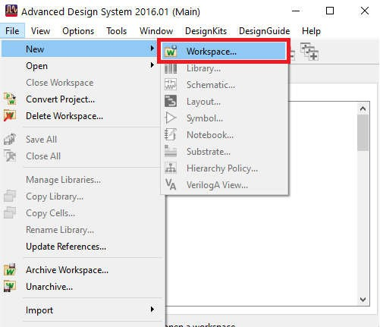
Interacting with the Workspace
The ADS Main Window enables you to create and manage ADS workspaces. A workspace is an organizer where you can group everything about a design, such as libraries, technology, schematic, layout, simulation data, and Momentum data. The entire ADS user interface and simulation operates within the currently open workspace.
To create a new workspace, go to File -> new -> workspace

Slide 5
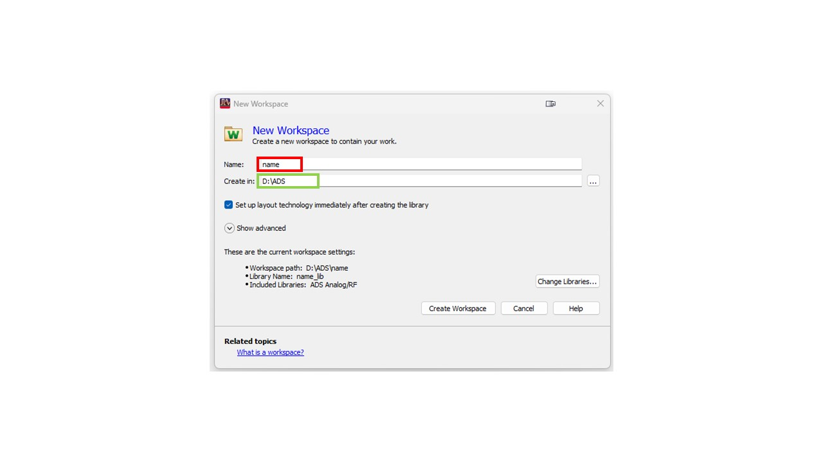
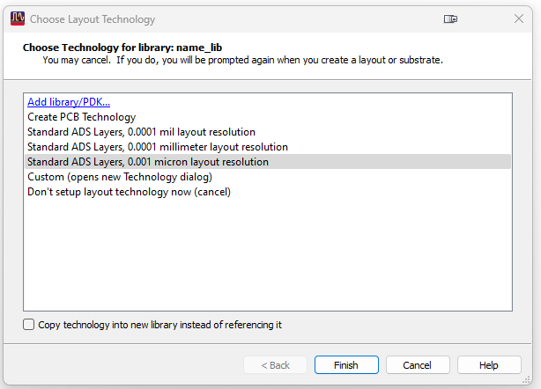
In the new window,
Name your workspace
Specify the directory to save your workspace
click on ‘Create Workspace’ to create a workspace
For the layout technology, please select the one that is highlighted in the image
Click on finish once completed

Slide 6
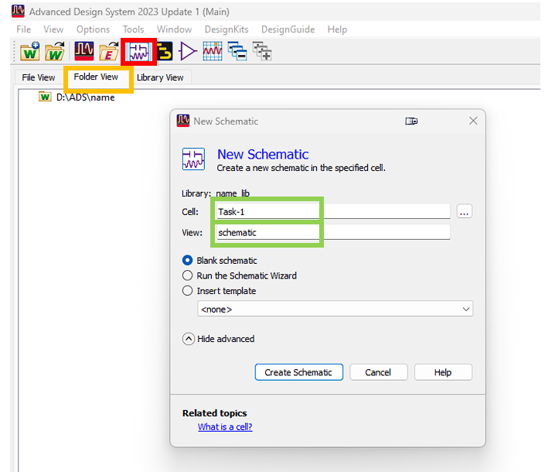
Creating a New Schematic
Create new schematic view: The schematic view is used to capture the design.
Select the new schematic icon (Red).
In the new window type your desired name (green), ensure the view is ‘schematic’ and press ‘create schematic’
Make sure that your folder view is active (Yellow).

Slide 7
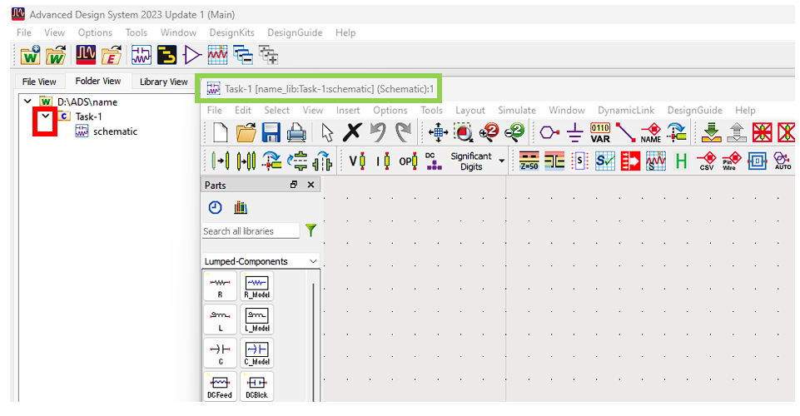
Your new schematic view can be found in folder view inside the folder “yourname”.
Click on the arrow (Red) to view the subfolders

Slide 8
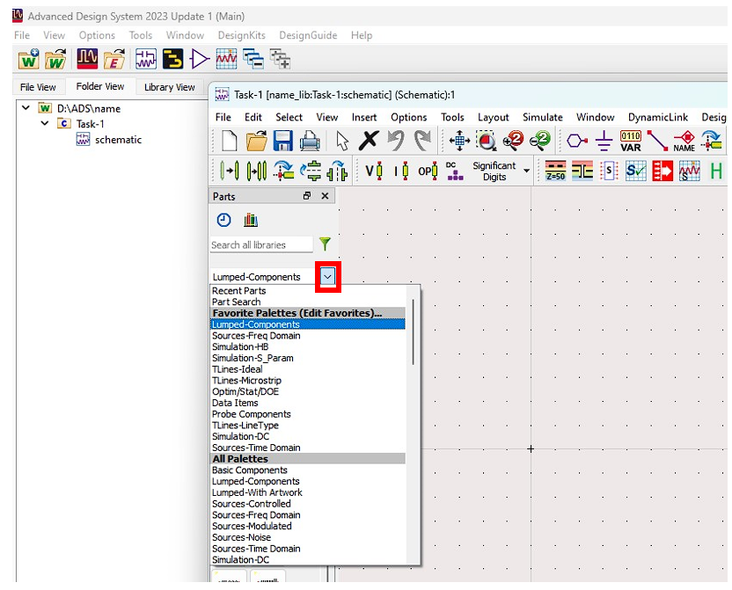
Placing Components in the Schematic
Components: Palette window is used to fetch all components in ADS.
In palette window, all components are categorized into groups to make it easier to find each component.
Click on the arrow to view to the available sets of components.

Slide 9
Project Overview
Objectives:
DC Simulation
S Parameter Simulation
You will learn through:
Task 1: DC Simulation of a resistive voltage divider
Task 2: S- Parameter Simulation of Gain Stage (Amp)
Task 3: Cascaded Gain and Computation of Cascaded Gain and Noise Figure
Task 4: Transmission Line Simulation
Task 5: Cascaded Gain Stage with Transmission Line

Slide 10
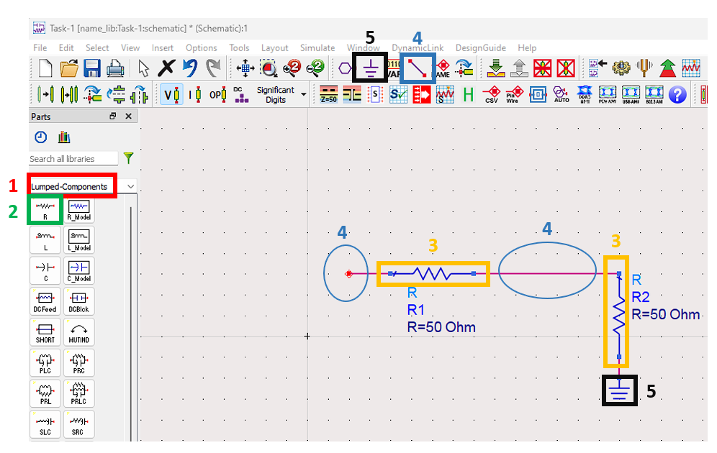
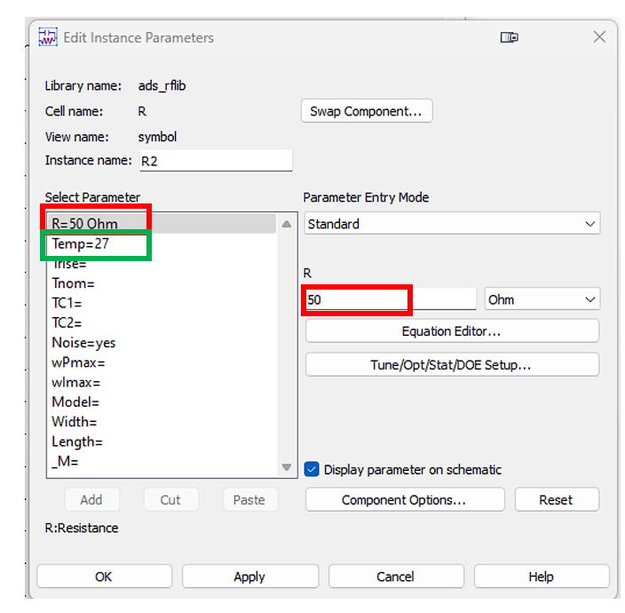
Task -1: Schematic Setup for DC Simulation
To learn the DC simulation environment, we will create a simple resistive voltage divider as follows:
In the palette window select Lumped-Components (1) category.
Select resistor ‘R’(2).
Place the resistors in your schematic (3).
Click on the wire icon (4) on tools bar and connect two resistors.
Click on the ground icon (5) and place it as shown in the figure.
To change the parameters of the Resistor, double click on the component and specify the value needed.
R1 = 1000Ω and R2 = 500Ω
For simulation purposes, set the temperature to be 27C.

Slide 11
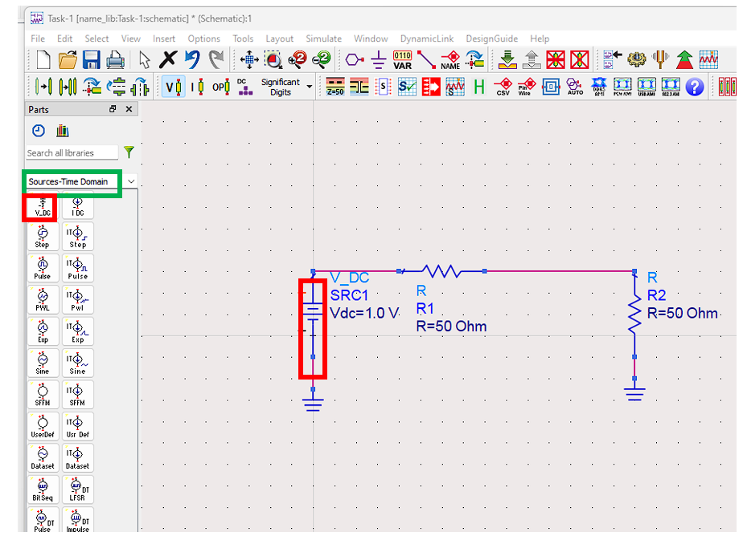
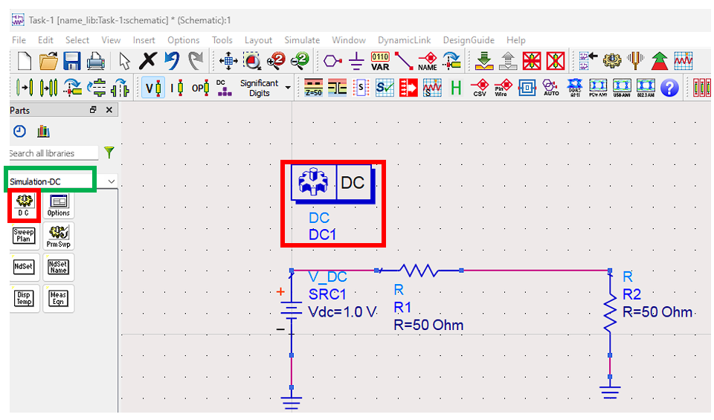
Task -1: DC Simulation Setup
In the palette window, change the category to Sources-Freq Domain.
Select V_DC from components and place it in your schematic.
Connect the dc voltage (Vdc) to the other components and place its ground.
Select the DC simulation component (DC) and place it in your schematic. Select V1 = 2V

Slide 12
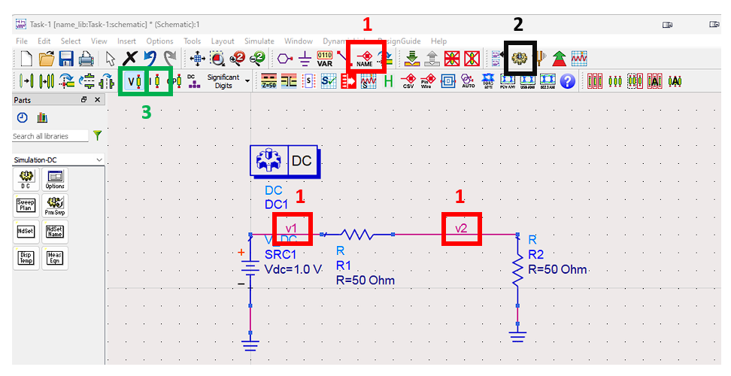
Task -1: DC Simulation Results
Place the labels to highlight the nodes of interest (1).
Click on the Run Simulation icon on the tool palette (2).
Annotate the voltages and the currents with the help of the annotate icon (3).

Slide 13
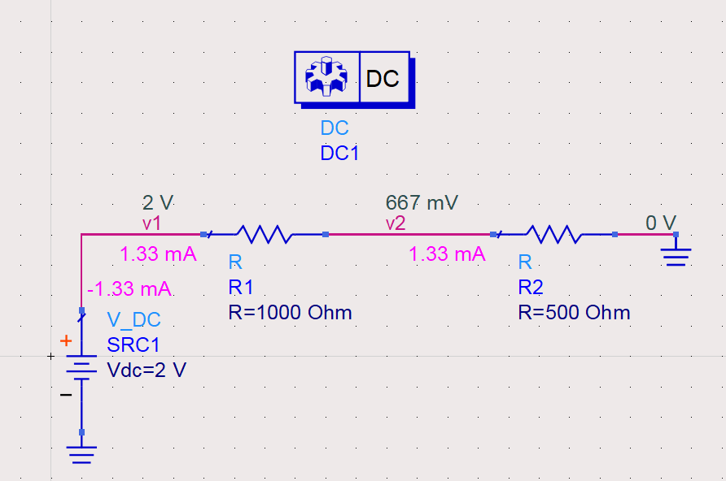
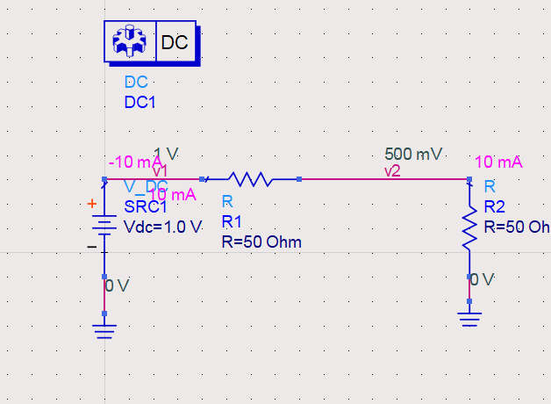
Task -1: DC Simulation REPORT
Reference figure:
Place your schematic screenshot here
Fill the below table with the DC simulation annotated values and your corresponding hand calculations:
 | SI Unit | Calculation | Simulation
Node-v2 (V) | Volts | 667mV | 667mV
Node-v2 (I) | Ampere | 1.33mA | 1.33mA

Slide 14
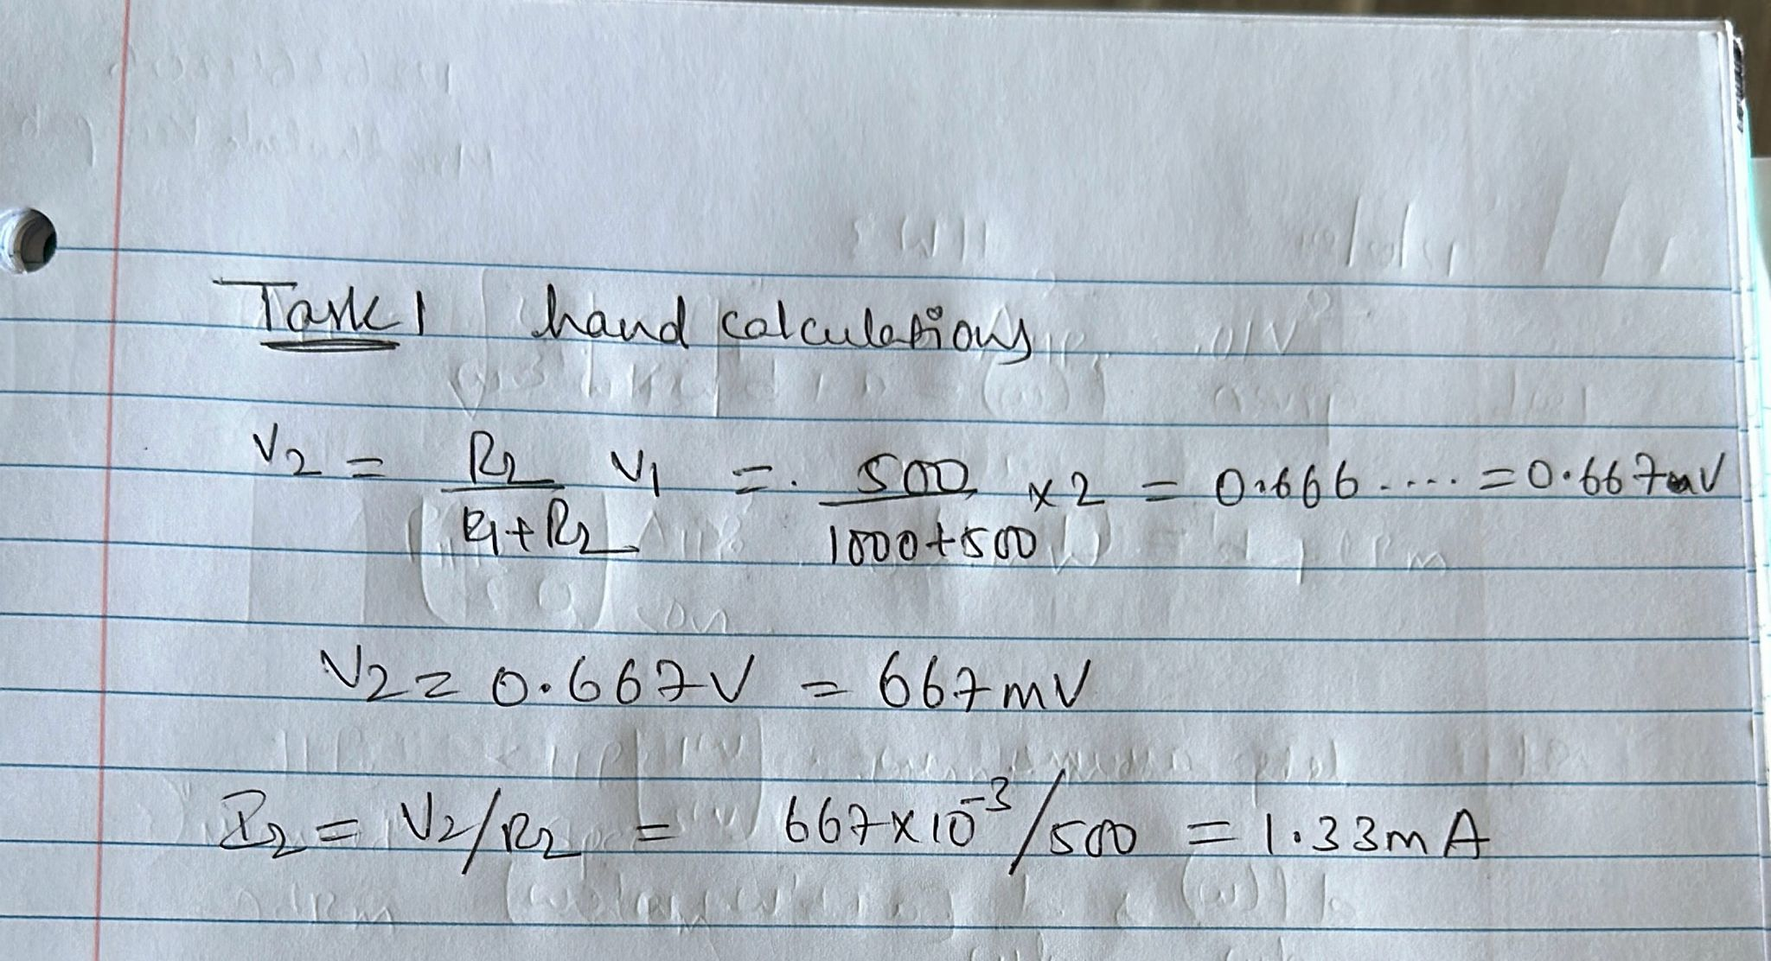
Task -1: DC Simulation - REPORT
Place a screenshot of your Hand Calculations for DC Simulation HERE

Slide 15
Task 2 – Scattering Parameter Simulation

Slide 16
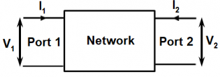
Task -2: S Parameters Intro
What are we learning?
In this section we will take a deep dive into the two-port network and the s-parameters.
How do we model them and simulate them?
How do we interpret the various plots associated with a two-port network?
* Image courtesy Analog Devices

Slide 17
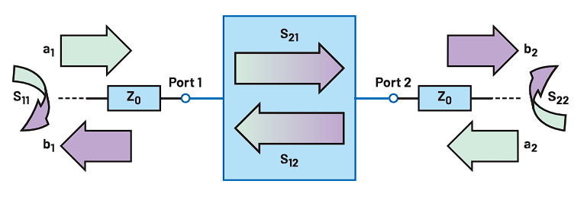
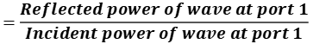
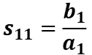
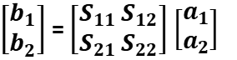
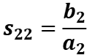
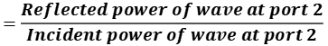
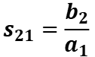
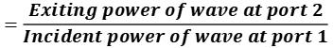
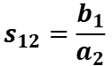
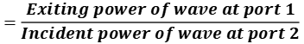
Task -2: S Parameters Intro
Introduction:
Scattering parameters or S-parameters are a mathematical representation of how RF energy propagates through a system and holds information of the fundamental characteristics.
$$s_{11}=\frac{b_{1}}{a_{1}}$$
$$=\frac{Reflected power of wave at port 1}{Incident power of wave at port 1}$$
$$s_{12}=\frac{b_{1}}{a_{2}}$$
$$=\frac{Exiting power of wave at port 1}{Incident power of wave at port 2}$$
$$s_{21}=\frac{b_{2}}{a_{1}}$$
$$=\frac{Exiting power of wave at port 2}{Incident power of wave at port 1}$$
The response of the network can be expressed by grouping S-parameters together into a scattering matrix, which relates the complex wave quantities at all of the network’s ports
$$s_{22}=\frac{b_{2}}{a_{2}}$$
$$=\frac{Reflected power of wave at port 2}{Incident power of wave at port 2}$$
$\left[\begin{matrix}b_{1} \\ b_{2}\end{matrix}\right]$ = $\left[\begin{matrix}S_{11} \\ S_{21}\end{matrix}\begin{matrix} S_{12} \\ { S}_{22}\end{matrix}\right]$ $\left[\begin{matrix}a_{1} \\ a_{2}\end{matrix}\right]$
* Image courtesy Analog Devices

Slide 18
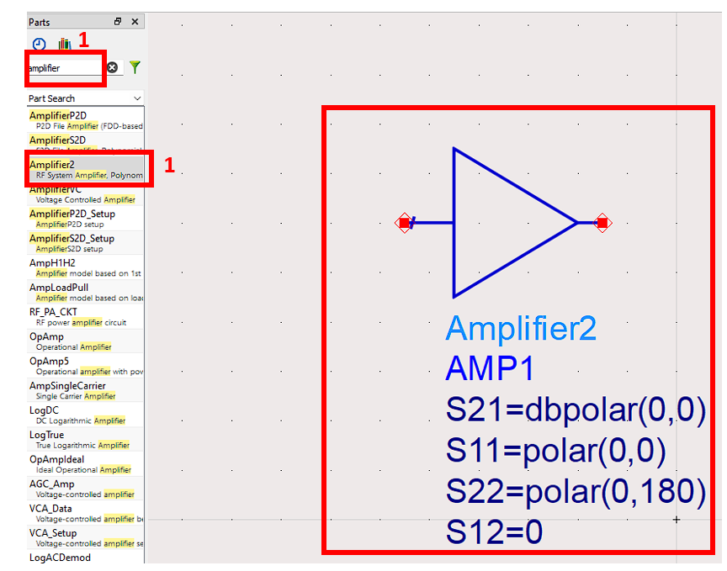
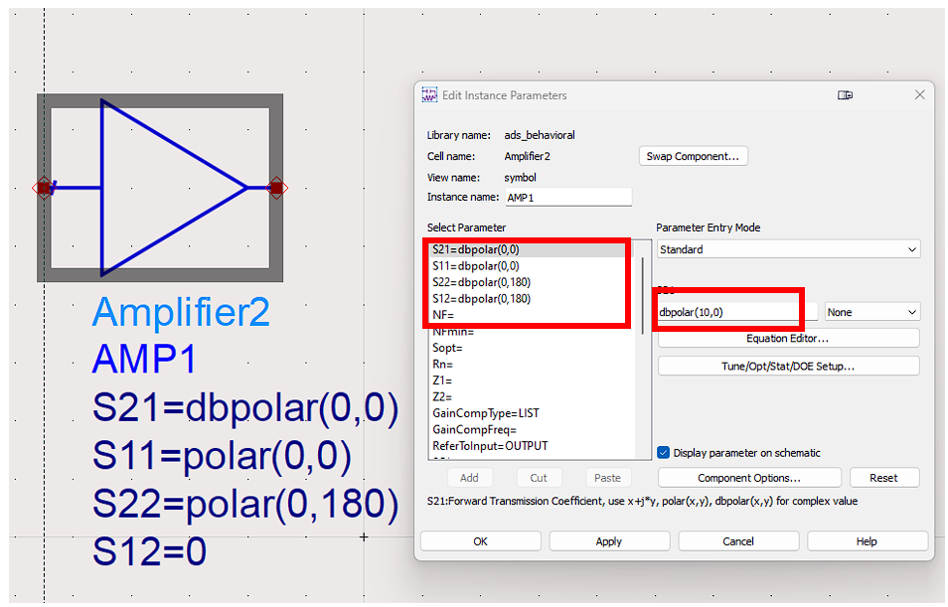
Task -2: S Parameters Simulation
Working with the tool:
Create a new schematic.
On the top left white space bar type “Amplifier” and place the amplifier in schematic.
Double-click on the amplifier and use the following s-parameters in polar coordinates:
S21=dbpolar(10,0)
S11=dbpolar(-20,0)
S22=dbpolar(-20,180)
S12=dbpolar(-50,0)
Select Amp noise figure NF=2 dB.
Check the “display parameter on schematic” and press ok. (Second figure).

Slide 19
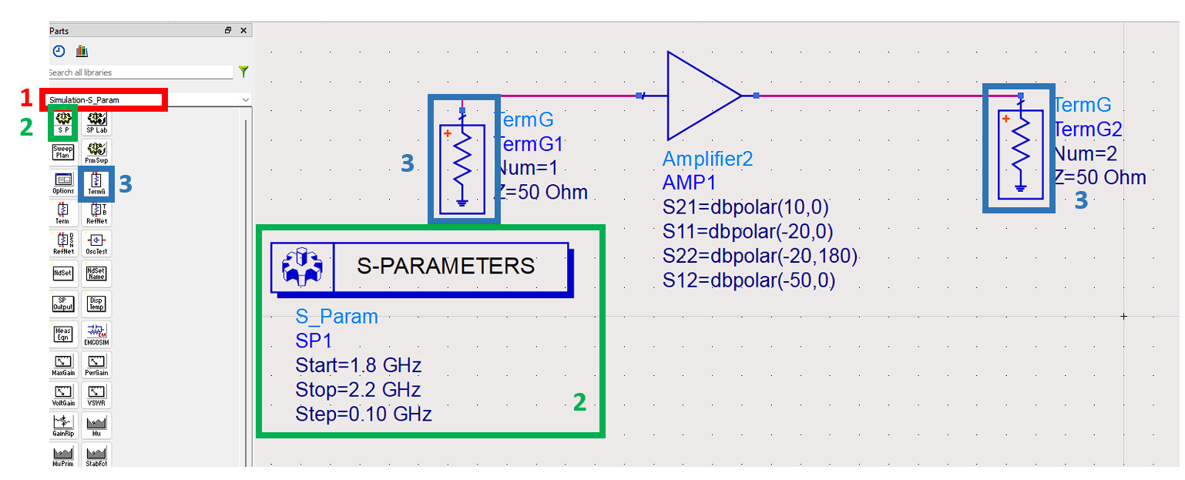
Task -2: S Parameters Simulation
Working with the tool:
In the palette window, choose Simulation- S_param category.
Click on SP icon and place it in the schematic.
Pick a frequency range from 1.8 GHz to 2.2 GHz with step=0.01 GHz.
Use Term (input/output terminal) component and place terminals at the input and output of your amplifier.

Slide 20
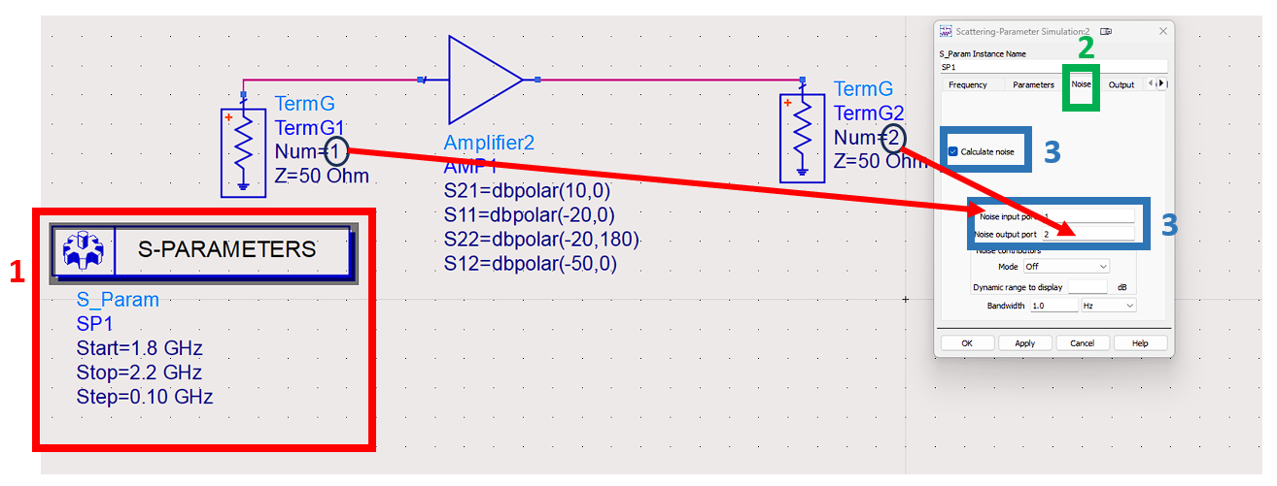
Task -2: S Parameters Simulation
Double click on the S-PARAMETERS
choose the third tab “noise”. Check the “calculate noise”.
Type 1 and 2 for noise input and output port sections and press ok.
Run the simulation - Once the simulation is finished, new result window will pop up.
NOTE: Because you are entering a constant value for each s-parameter, you will have a flat line response over frequency.

Slide 21
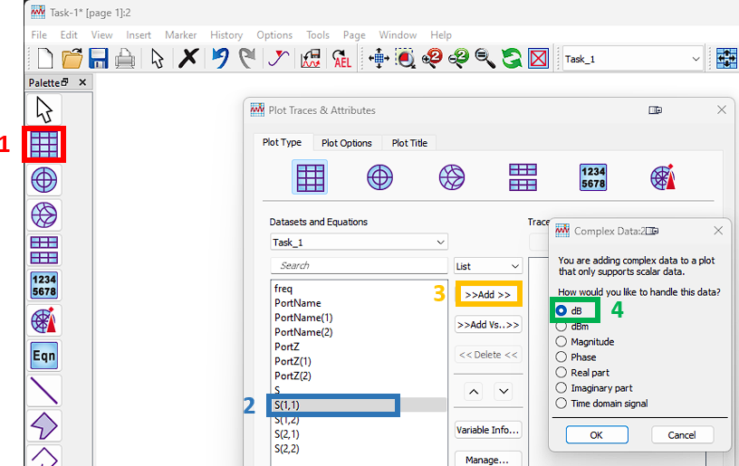
Task -2: S Parameters Simulation
Press rectangular plot on the left panel (1) and place it in white space. (note one plot pane for each parameter and one for noise)
Click on each S-parameter (2) and click on add (3).
In the new window “complex data” select dB (4) and press ok.
If you press ok again you will observe the results.
Repeat the same procedure for the noise figure (5)

Slide 22
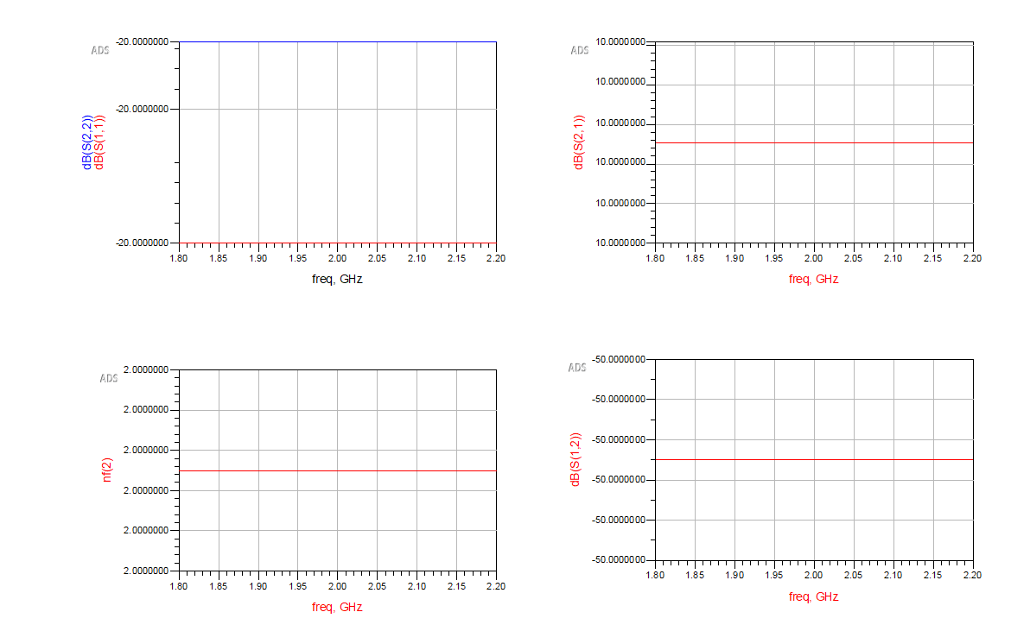
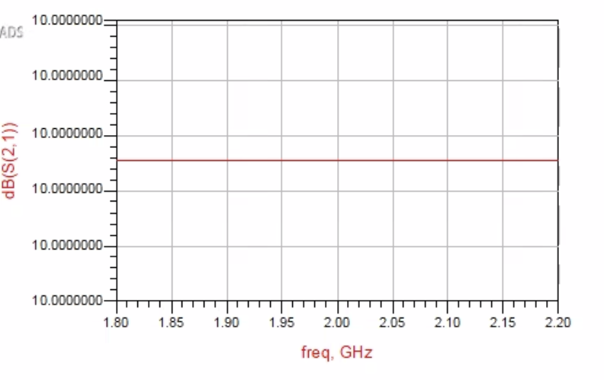
Task -2: S Parameters REPORT
Plotting
Please use this plot as reference.
Set the scales and the points of the graph accordingly.
S11 & S22 vs. Freq
S21 vs. Freq
Place your screenshot here
Place your screenshot here
NF vs. Freq
S12 vs. Freq
Place your screenshot here
Place your screenshot here
To modify the scales, double click on the graph and go to the plot options window.
Specify the scale according to your requirements
To plot two parameters on the same graph, hold control and select
All values are supposed to be in dB

Slide 23
Task -3: Cascaded Stages

Slide 24
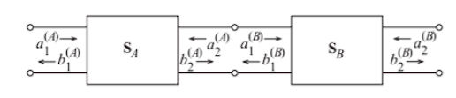
Task -3: Cascading Stages Introduction
What are we learning?
In the previous task, we discovered what one device can do. But, in practice, a typical RF chain (receiver or transmitter) has many subcomponents connected to each other forming what we call a cascade.
We will be tackling the following in this section:
How to build the simulation mode of the cascaded network.
The equations governing a cascaded network and how various parameters propagate through the cascade
Finally, we interpret the plots and then compare the results with our hand calculations
* Image courtesy Libretexts

Slide 25
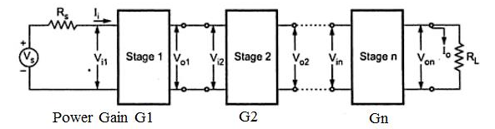
Task -3: Cascading Stages Theory
How do we cascade?
The typical process of cascading includes placing one device after another, isn't that simple? It should be. But, as we cascade stages, we need to understand how placing additional devices impacts the overall chain performance.
We basically model the entire chain as one black box that houses all of the parameters of all devices (subcomponents) connected together.
We focus on two parameters here, the gain and the noise figure across stages.
* Image courtesy Everythingrf

Slide 26
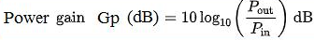
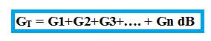
Task -3: Cascading Stages Theory
Parameters:
Let’s gain something!
The gain of the RF stage is the ratio of power at the output of a block to the applied power at the input. We can represent this in decibels:
The gain for a cascade is the summation of the gain contributed by every device in the structure when represented in decibels.
* Image courtesy Everythingrf

Slide 27
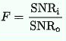
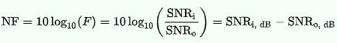
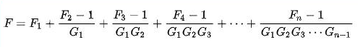
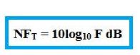
Task -3: Cascading Stages Theory
Parameters:
Noise! Noise! Noise!
The noise factor of any two-port network is the ratio SNR at the input to SNR at the output.
The cascaded noise figure is a little tricky, the noise figure of each stage must be converted to a scalar and then placed in the Friis formula below. We observe that the overall noise is impacted most by the first gain stage (G₁).
Total noise figure represented in decibels.
* Image courtesy Everythingrf

Slide 28
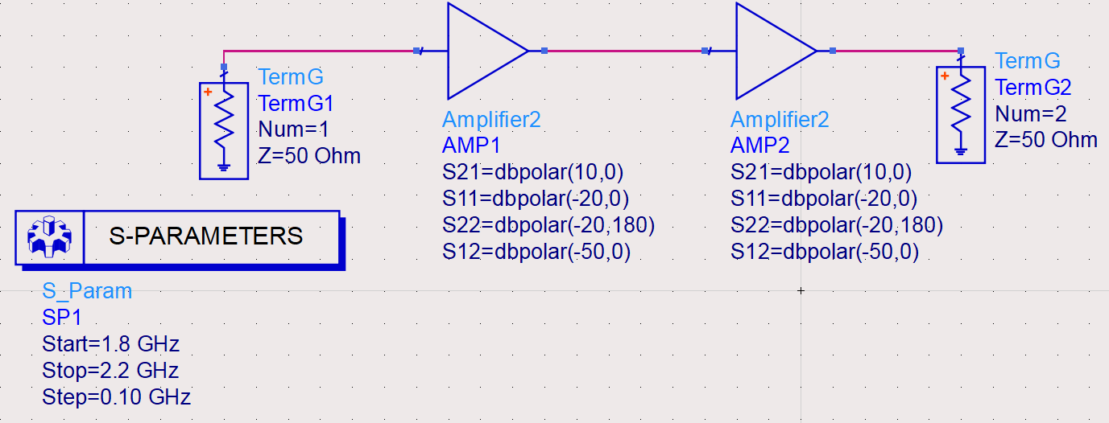
Task -3: Cascading Stages Simulation
Working with the tool:
Create a new schematic.
On the top left white space bar type “Amplifier” and place the amplifier in schematic.
In the palette window, choose Simulation- S_param category.
Click on SP icon and place it in the schematic. Pick a frequency range from 1.8 GHz to 2.2 GHz with step=0.01 GHz.
Keep S11 and S22 the same.
Select S21 (Amp-1) to 20dB and S21 (Amp-2) to 10dB.
Set NF1 = 2dB and NF2 = 2.5dB.
Use Term (input/output terminal) component and place terminals at the input and output of your amplifier.

Slide 29
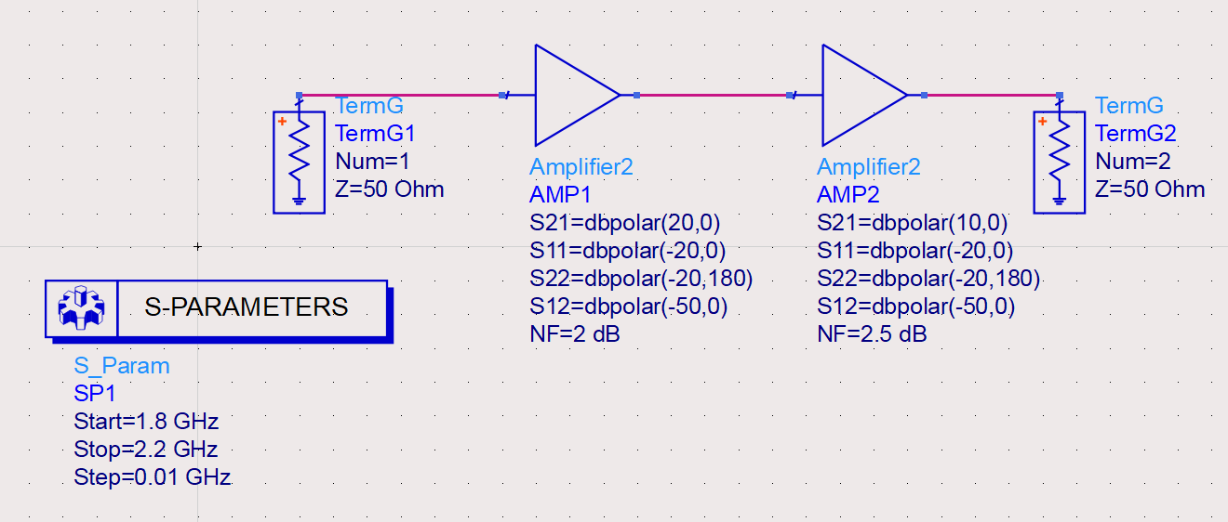
Task -3: Cascading Stages REPORT
Please use this plot as reference.
Set the scales and the points of the graph accordingly.
Place your Schematic screenshot here
NOTE: Your curves will be flat lines. Your response will NOT be the same as this plot. This is an example.
Fill the table below with the annotated values and the corresponding hand calculations:
 | SI Unit | Calculation | Simulation
Gain | Magnitude | 31.62 | 31.3
Gain | dB | 30 | 29.9
NF | Magnitude | 1.59 | 1.59
NF | dB | 2.014 | 2.02

Slide 30
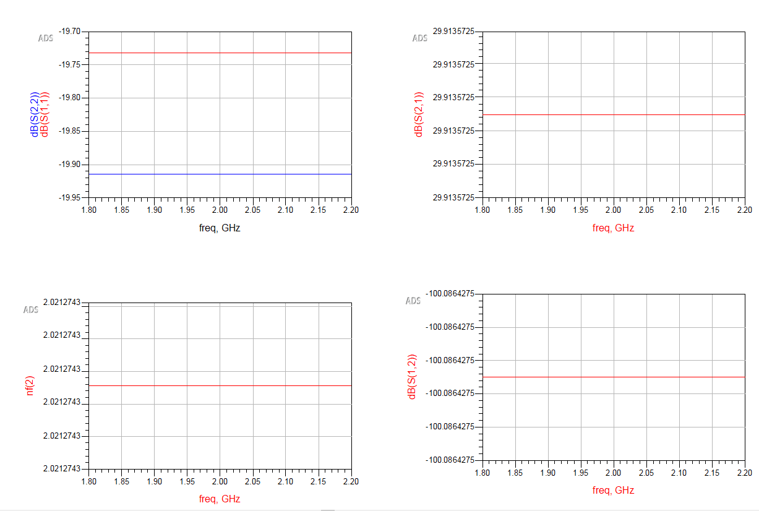
Task -3: Cascading Stages REPORT
S11 and S22 vs. Freq
Plotting
S21 (Gain) vs. Freq
NF (overall NF) vs. Freq
S12 vs. Freq

Slide 31
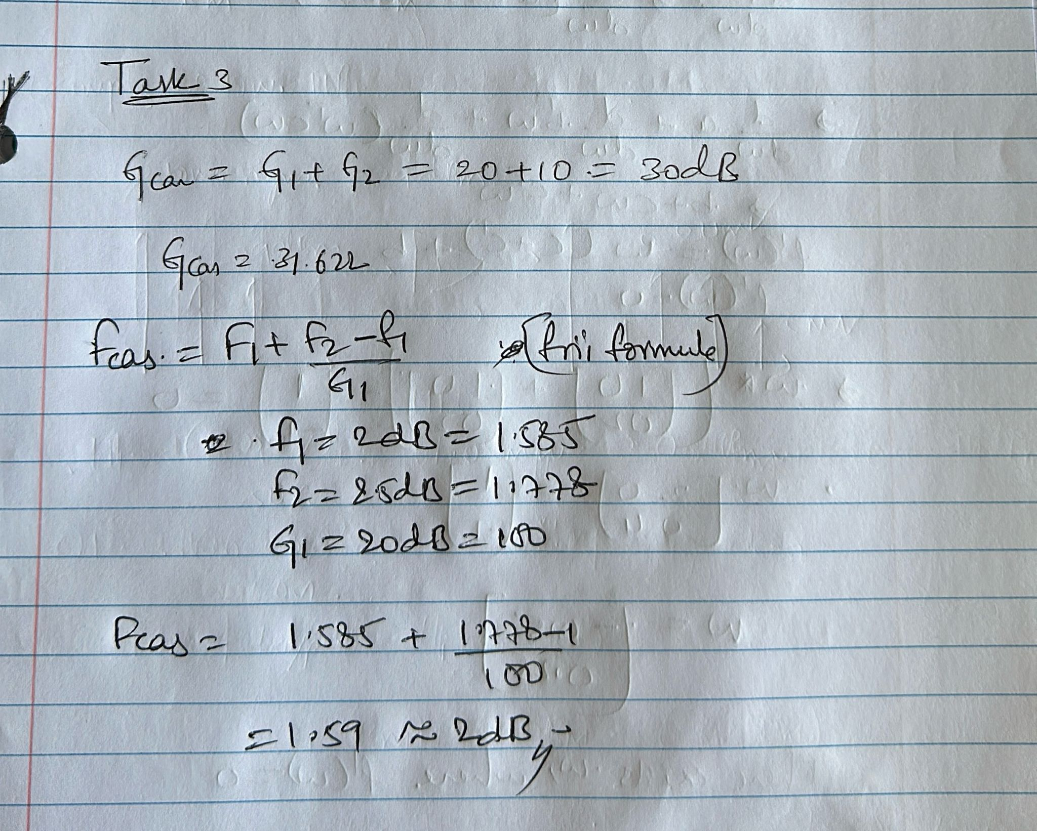
Task -3: Cascading Stages REPORT
Place your screenshot here
Hand Calculations for gain and noise figure

Slide 32
Task -4: Transmission Line

Slide 33
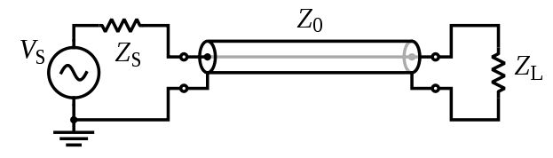
Task -4: Transmission Line Introduction
Now we introduce the transmission line:
The transmission line is a specialized cable or structure designed to conduct electromagnetic waves in a contained manner.
We will be tackling the following in this section:
Simulating the transmission line.
Understanding how length and width effect the impedance of the line.
Finally, we interpret the plots and then compare the results with our hand calculations.
* Image courtesy Wikipedia

Slide 34
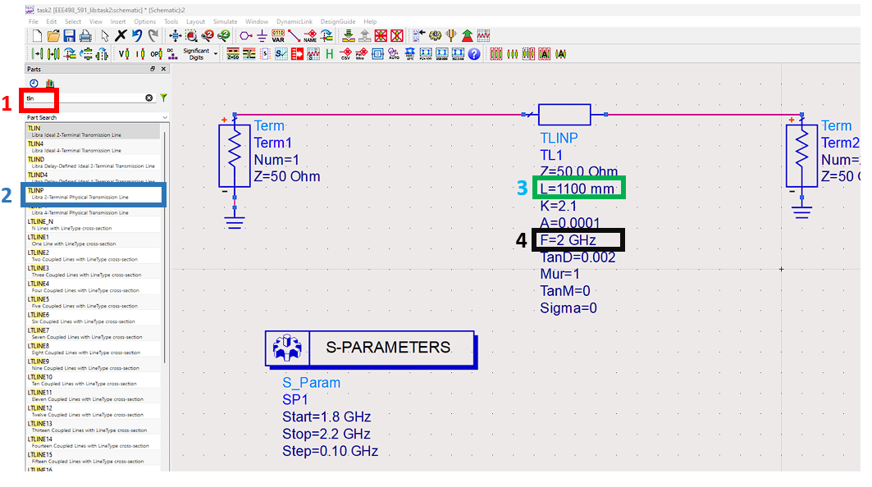
Task -4: Transmission Line Simulation
Working with the tool:
Create a new schematic.
On the top left white space bar type “Tlin” and place the TLINP in schematic.
Change the length of the TX line to 1100mm.
Change the center frequency of the TX line to 2GHz.
Use Term (input/output terminal) component and place terminals at the input and output of your amplifier.
Run the simulation.
Plot S11 S22 S21 and noise figure (NF).

Slide 35
Task -4: NOTES About Transmission Line Hand Calculation
You may calculate the loss (i.e. Gain) of the transmission line using the material properties given to you in slide 34.
BUT, these equations are not trivial and we have not learned them in this course.
So, I urge you instead to estimate the Gain and NF of the transmission line ignoring the loss tangent (TanD of slide 34). Assume there is no loss due to material properties and only consider loss/reflections due to transmission line mismatch.
Ask yourself, is the impedance of the transmission line (Z) the same as the port impedances (50 Ohms)? If yes, do I get any loss ideally?
If you do not have loss, what is the magnitude of your Gain? What is the magnitude of your Noise Factor?
You may use the above assumptions to find the Gain and NF “Calculation” in the next slide.

Slide 36
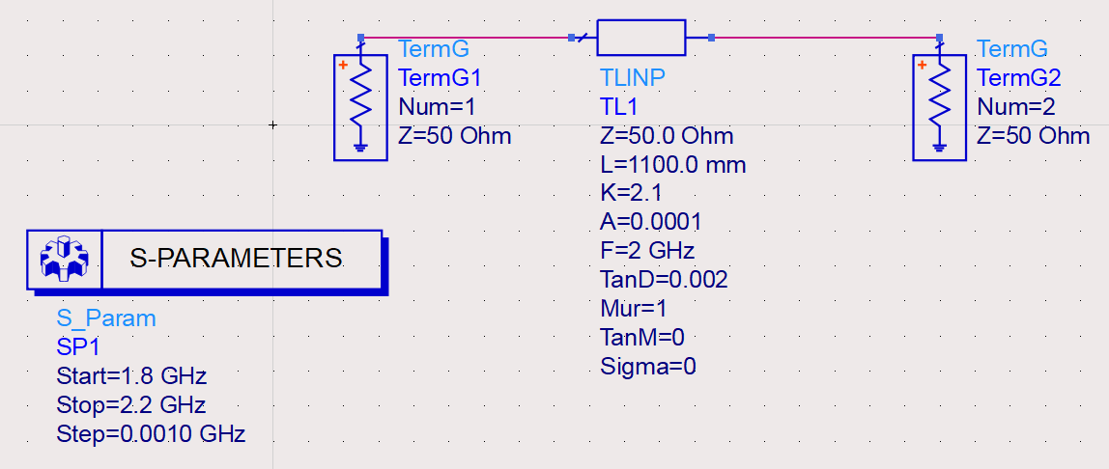
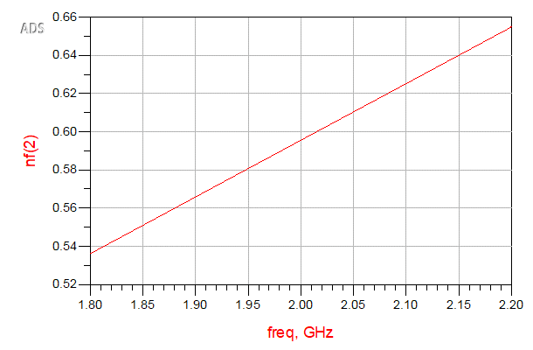
Task -4: Transmission Line REPORT
Please use this plot as reference.
Set the scales and the points of the graph accordingly.
NOTE: Your curves will be flat lines. Your response will NOT be the same as this plot. This is an example.
Place your Schematic screenshot here
Fill the table below with the annotated values and the corresponding hand calculations:
 | SI Unit | Calculation | Simulation
Gain | Magnitude | 1 | 0.93
Gain | dB | 0 | -0.58
NF | Magnitude | 1 | 1.15
NF | dB | 0 | 0.596

Slide 37
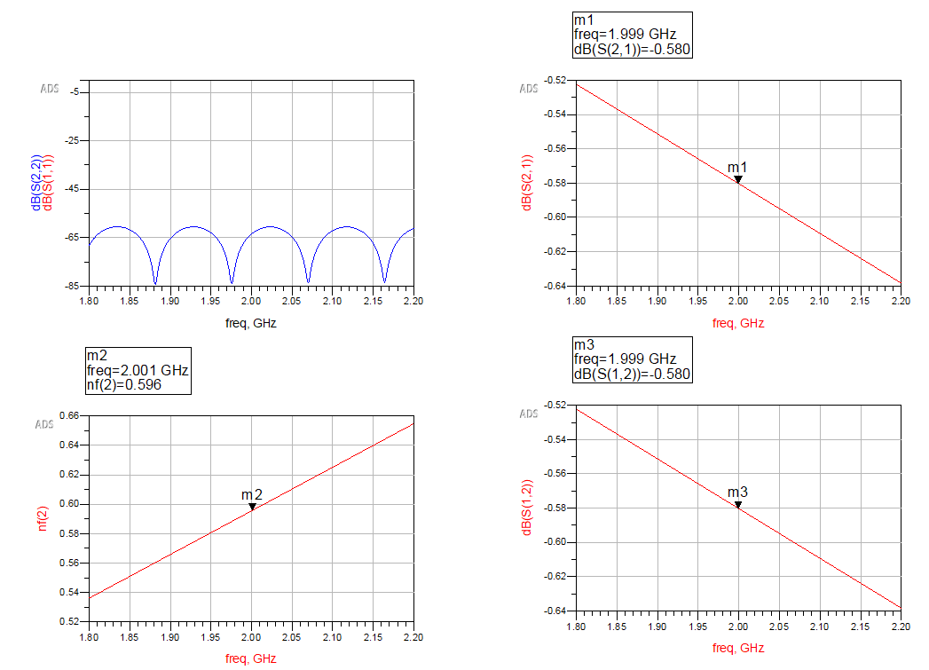
Task -4: Transmission Line REPORT
Plotting
S11 and S22 vs. Freq
S21 (Gain) vs. Freq
NF vs. Freq
S12 vs. Freq

Slide 38
Task -5: Cascaded Gain Stage with Transmission Line

Slide 39
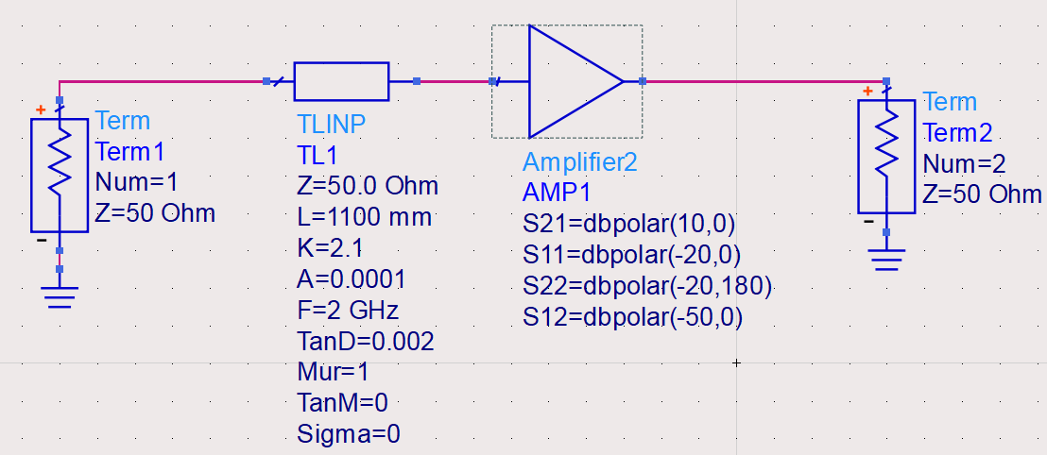

Task -5: Cascading Stages w/Transmission line
Now we introduce the transmission line with a gain stage (amplifier).
We will be tackling the following in this section:
Cascading the transmission line with an amplification stage.
Use the simulated noise figure and gain from the previous task 4 of the transmission line to estimate the noise figure and the gain for the hand calculations in this task.
Interpret the plots and then compare the results with our hand calculations.
5A
5B

Slide 40
Task -5A: T-line then Cascaded Gain Stage
For the 5A schematic, connect the transmission line before the Amplifier.
Shown in figure to the right.
Create this schematic and simulate the s-parameters using what you have learned in the previous tasks.
Hand Calculate the Overall Gain and NF based on the theory/equations that you have learned.
USE THE SIMULATED GAIN AND NOISE FIGURE OF THE TRANSMISSION LINE, AS WE DID NOT ACCURATELY CALCULATE THESE WITH HAND ANALYSIS.

Slide 41

Task -5A: T-line then Cascaded Gain Stage REPORT
Please use this plot as reference.
Set the scales and the points of the graph accordingly.
NOTE: Your response will NOT be the same as this plot. This is an example.
Place your Schematic screenshot here
Fill the table below with the annotated values and the corresponding hand calculations:
 | SI Unit | Calculation | Simulation
Gain | Magnitude | 2.958 | 2.958
Gain | dB | 9.42 | 9.419
NF | Magnitude | 1.773 | 1.815
NF | dB | 2.487 | 2.590

Slide 42

Task -5A: T-line then Cascaded Gain Stage REPORT
S11 vs. Freq
Plotting
NF (overall NF) vs. Freq
S21 (Gain) vs. Freq
S22 vs. Freq

Slide 43

Task -5A: T-line then Cascaded Gain Stage REPORT
Place your screenshot here of
Hand Calculations for gain and noise figure

Slide 44
Task -5B: Gain Stage Followed by T-line
For the 5B schematic, connect the transmission line after the Amplifier.
Shown in figure to the right.
Create this schematic and simulate the s-parameters using what you have learned in the previous tasks.
Hand Calculate the Overall Gain and NF based on the theory/equations that you have learned. USE THE SIMULATED GAIN AND NOISE FIGURE OF THE TRANSMISSION LINE FROM TASK 4, AS WE DID NOT ACCURATELY CALCULATE THESE WITH HAND ANALYSIS.

Slide 45

Task -5B: Gain Stage Followed by T-line REPORT
Please use this plot as reference.
Set the scales and the points of the graph accordingly.
NOTE: Your response will NOT be the same as this plot. This is an example.
Place your Schematic screenshot here
Fill the table below with the annotated values and your corresponding hand calculations:
 | SI Unit | Calculation | Simulation
Gain | Magnitude | 2.958 | 2.95
Gain | dB | 9.42 | 9.42
NF | Magnitude | 1.627 | 1.599
NF | dB | 2.11 | 2.04

Slide 46

Task -5B: Gain Stage Followed by T-line REPORT
Plotting
S11 vs. Freq
NF (overall NF) vs. Freq
S21 (Gain) vs. Freq
S22 vs. Freq

Slide 47

Task -5B: Gain Stage Followed by T-line REPORT
Place your screenshot here for
Hand Calculations for gain and noise figure

